Slide 1
How to write titles in english
Príloha č. 6

Slide 2
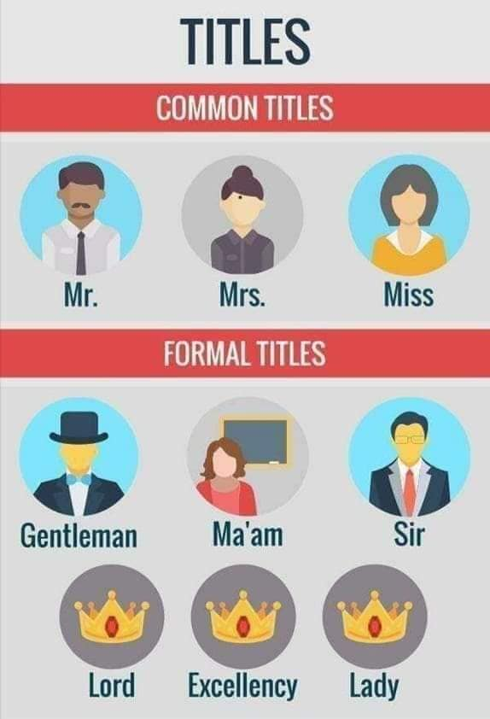
Mr.
for men
regardless of marital status
without another professional or academic title
Gentleman
originaly the term reffered to a social rank, standing below an exquire
Madam
for women
a term of general respect
Mrs.
for maried women
without another professional or academic title
Sir
for men, formally if they have a British knighthood or if they are a baronet
Lord
for male barons, viscounts, earls and marquesses, as well as ome of their children
Miss
for girls and unmarried women
in UK - for married women who continue to use their maiden name
in UK schools to adress female teachers, regardless of marital status
Excellency
a title of honor
given to certain high officials, as governors, ambassadors, royalty, nobility, and Roman Catholic bishops and archbishops
Lady
for female peers with the rank of baroness, viscountess, countess, and marchioness, or the wives of men who hold the equivalent titles

Slide 3
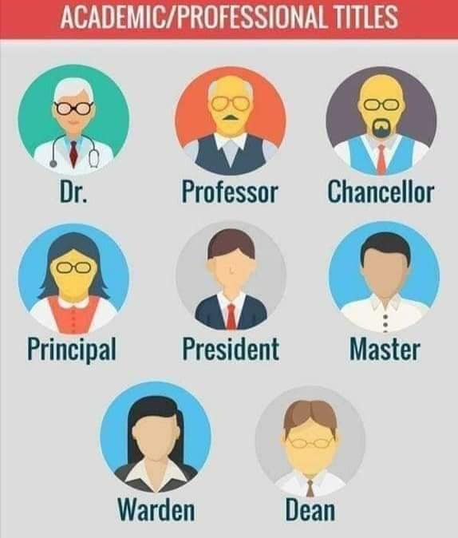
Dr.
abbreviation for Doctor
for the holder of a doctoral degree (e.g. PhD, or MD
for medical practitioners
President
may apply to a person holdint the title of president, or presiding over certain other governmental bodies
Professor
for a person who holds the academic rank of profesor in a university or other institution
Master
a male schoolteacher
Warden
a person responsible for the supervision of a particular place or activity of for enforcing the regulations associated with it
Chancellor
for the chancellor of a university
Principal
a head of a school/organisation
Dean
the head of a university faculty or department or of a medical school

Slide 6
Capitalization Sir, ma´am/madam, miss, dame
TIP
At the start of an email or letter, prefer to use the person’s name instead of sir or ma’am.
EXAMPLES
Dear Dr. Jones / Dear Ma’am salutation at the start of an email to your thesis supervisor
Dear Minerva Dash / Dear Madam when writing to the editor of a literary magazine
Dear Mr. Remy / Dear Sir when addressing the hiring manager in a job application
Dear Sir or Madam
(salutation at the start of an email)
Yes, Madam Prime Minister
(before another title)
We met Sir Terry Pratchett at a fair in 1999.
(title before a name)

Slide 7
capitalization Sir, ma´am/madam, miss, dame
When not in a salutation or before a name, terms like sir and ma’am are generally lowercased, although they may also be capitalized, depending on the writer’s preference.
EXAMPLES
Hello, sir, how are you?
Sorry, sir, I’m afraid you don’t have a reservation.
No, ma’am, breakfast isn’t included.
Excuse me, miss, are you a student?
Note:
Whether to use forms of respectful address like sir and ma’am depends greatly on regional preferences. In some parts of the world, people may not appreciate a gendered form of address. In many countries, however, using sir or ma’am is still preferred in formal situations—for example, while speaking to a customer or a teacher. Note that ma’am is a contraction of madam and requires an apostrophe: ma’am, not maam.

Slide 8
Capitalization Social and professional titles
Dr. or Mr./Ms./Mrs./Miss?
When addressing or speaking about a person, remember that professional and honorific titles take precedence over social titles. If a person has a professional title like doctor or professor, introduce or address them using this title instead of social titles like Mr., Mrs., and Ms.
EXAMPLES:
Here is your book, Dr./Mr. Green.
How are you, Dr./Mrs. Rao?
Our guest speaker today is Prof./Ms. Gomez.
This pizza is for Sir Anthony Hopkins / Mr. Hopkins.
This is a biography of Dame Judi Dench / Ms. Dench.
Use either a person’s given name or their full name after the titles Sir and Dame, never just the surname.
EXAMPLES:
I met Sir Sean Connery / Sir Connery—well, James Bond—at a coffee shop in London in ’91.
Dame Agatha Christie / Dame Christie is one of the most popular writers in British publishing history.

Slide 9
Capitalization civil, military, religious and royal
For most official titles, including civil, military, religious, and royal, the rule is to capitalize when used before or in place of a name, but to lowercase when used in general as a common noun.
EXAMPLES
Anita met President Obama in 2013.
Many have criticized Prime Minister Johnson’s handling of the pandemic.
Today, I learned that Queen Victoria had sponge cake for tea.
but:
The president is the head of state.
Neither the prime minister nor the president has addressed the controversy.
She was a queen who lived in the nineteenth century.

Slide 10
Academic titles and degrees
Doctor´s degrees:
PhD/Ph.D. | Doctor of Philosophy | PhDr./Ph.D. – doktor/ka filozofie
LLD/L.L.D. | Doctor of Laws | JuDr. – doktor/ka práv
MD/M.D. | Doctor of Medicine | MUDr. – doktor/ka všeobecného lekárstva
DD/D.D. | Doctor of Divinity | ThDr. – doktor/ka teológie
Doctor´s degreee in such forms are written after the name and divided by coma.
Example:
Professor D. H. Forster, Ph. D.

Slide 11
academic titles and degrees
Master´s degree
MA | Master of Arts | magister/ka filozofie (Mgr.)
MSc | Master of Science | magister prírodných vied
MBA | Master of Business Administration | magister obchodných vied
Example:
David Collins, MBA

Slide 12
Clerical orders tituly/pozície duchovných
archbishop, Catholic
archbishop, Church of England – The Most Reverend and Right Honourable the Lord Archbishop of...
bishop, Catholic – The Right Reverend John B. Stone
Bishop of –
bishop, Protestant
cardinal – His Eminence Cardinal Stone
His Eminence the Cardinal
priest, Catholic – The Reverend John B. Stone – katolícky kňaz
The Reverend Dr. John B. Stone
The Reverend John B. Stone, D. D.
chaplain – kaplán
clergyman/clergywoman, Protestant – The Reverend Alice C. Foster, D. D.
- anglikánsky, protestanský duchovný/á
The middle name is abbreviation.

Slide 13
diplomats accredited to a foreign country diplomati akreditovaní v zahraničí
ambassador, American – (official) the Honorable – formálny titul
americký veľvyslanec
- (social) His/Her Excellency – spoločenský titul
(US) The Honorable
Example:
His Excellency Mr Donald B. Rice
The British Ambassador

Slide 14
military ranks vojenské hodnosti
Cpt./Capt. (captain) | Captain/Capt. Jerome D. Cook | kapitán
Maj. (major) | Major/Maj. Jerome D. Cook | major
Col. (colonel) | Colonel/Col. Jerome D. Cook | plukovník
Gen. (general) | General/Gen. Jerome D. Cook | generál

