Slide 1
Geniko Lykeio Mouzakiou
A brief presentation about our origins, Mouzaki

Slide 3
Where Mouzaki is located
Mouzaki is the capital of the homonymous municipality.
Located on the south-west part of the Thessaly plain, on the banks of Pamisos river
18 and 25 km away from the cities Trikala and Karditsa, respectively
Historical, financial and administrative centre

Slide 4
Inhabitants
The city’s and municipality’s population is 1.961 and 13.122, respectively
Agriculture, livestock, trading and working in the public domain is what people do for a living
Traditional forms of employment include metalworkers, winemakers and vineyard workers
Local people harvesting grapes to produce wine

Slide 5
Historical facts
Long history along with lots of archaeological findings

Slide 6
Ancient and Byzantine era
Two kilometres northwest of Mouzaki, where Episkopi is today, the ancient town of Gomfi existed
There were sturdy defense walls
During the 6th century AD, the walls were renovated by the emperor Justinian
During the Byzantine era, it served as the base of the bishop
Remnants of ancient city Gomfi

Slide 7
Turkish occupation
The whole area of Mouzaki during the Turkish occupation was the fief of a sipahi ( feudal cavalryman) from Fanari and belonged to the vilayet (Ottoman province) of Fanari
On 10/05/1881 it was annexed to the free part of Greece, after the Istanbul conference
Modern Gomfi

Slide 8
World War 2 occupation
On 8/6/1943 Italian conquerors killed every citizen they found in the village and destroyed everything
After the liberation, the reconstruction of Mouzaki and the surrounding area followed
Remains of ancient Gomfi

Slide 9
Historical sights in Mouzaki

Slide 10
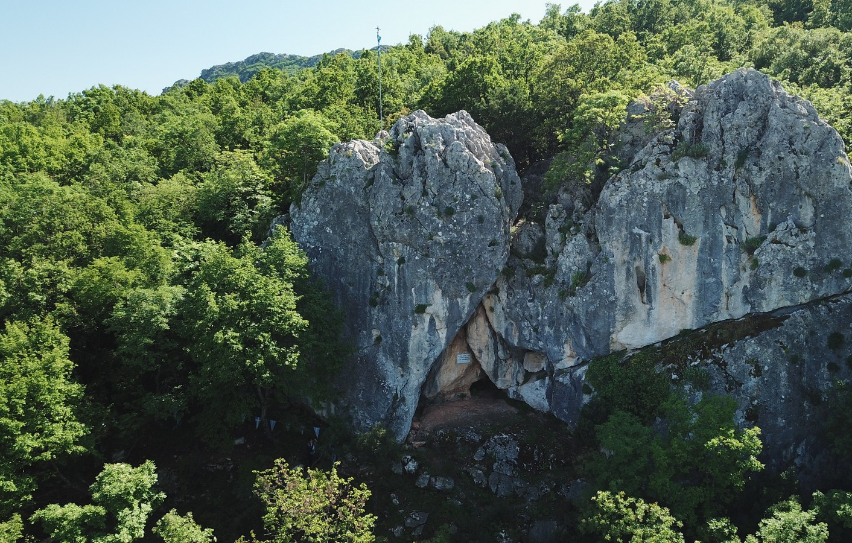
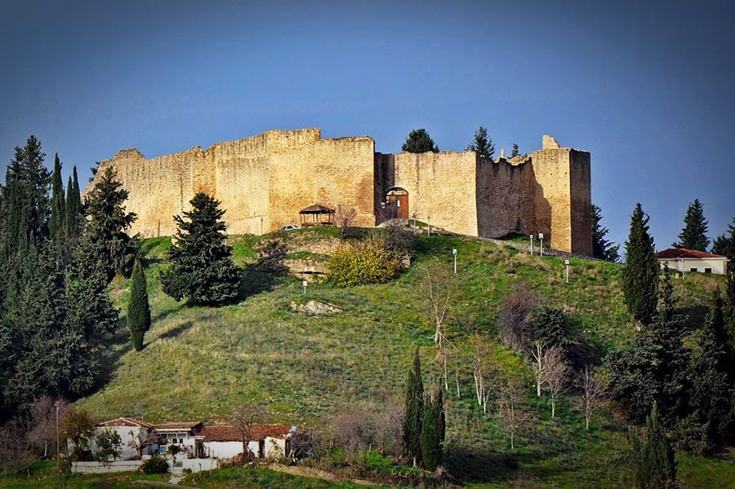
Karaiskakis’ Cave
Fanari Castle

Slide 11
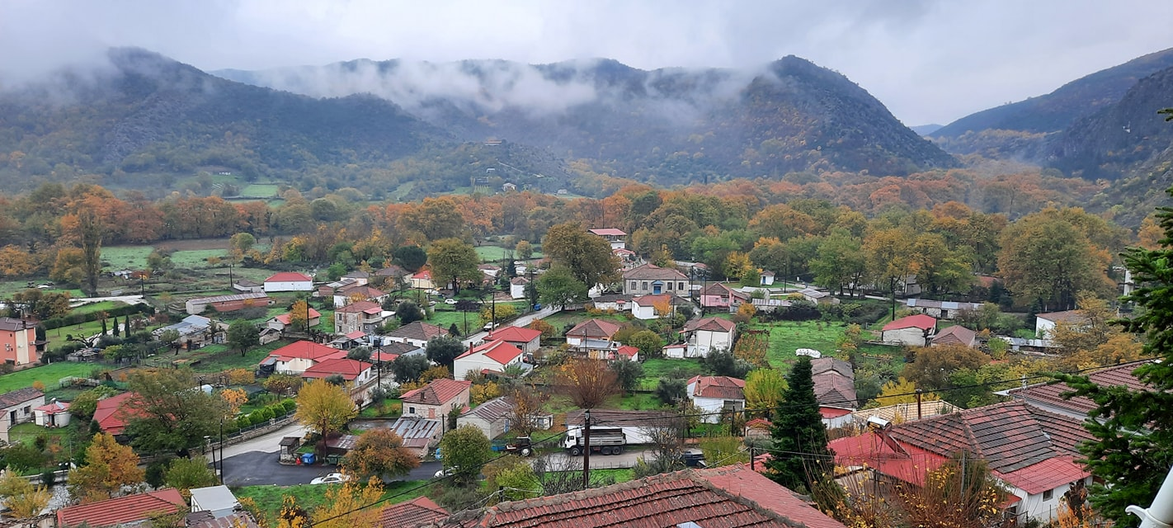
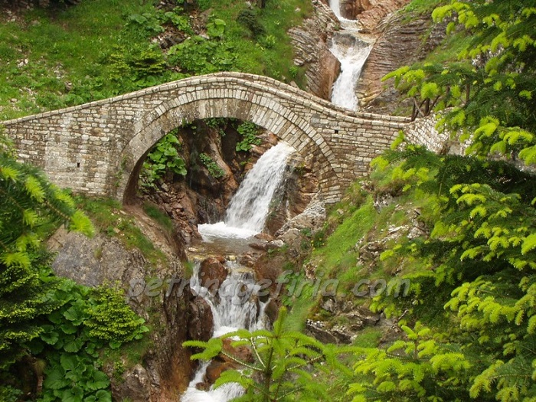
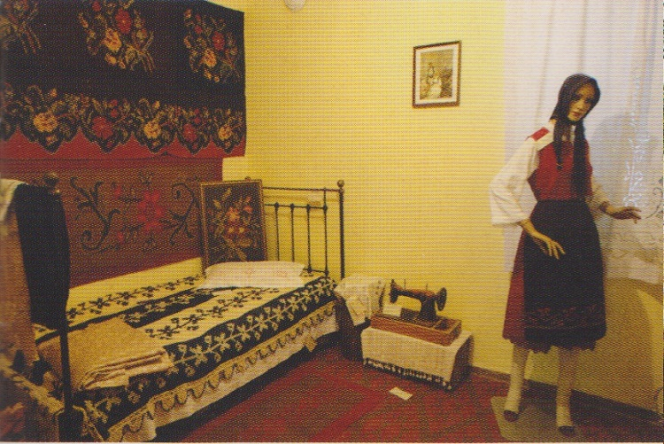
Pyrgos Ithomis
Bridge of Anthoxori
Folklore museum of Mouzaki

Slide 12
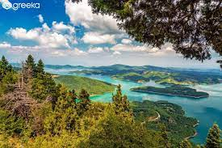
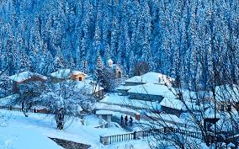
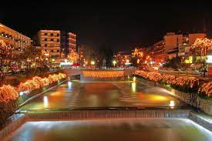
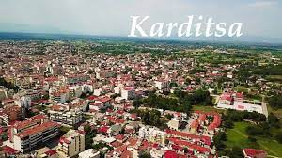
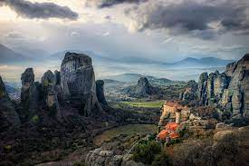
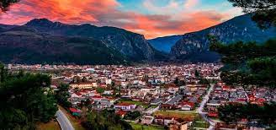
Pertouli 28km
Trikala 18km
Karditsa 25km
Lake Plastiras 17km
Mouzaki
Fanari Castle 12km
Meteora 40km

Slide 13
Seeking adventure
Extreme activites in our region

Slide 14
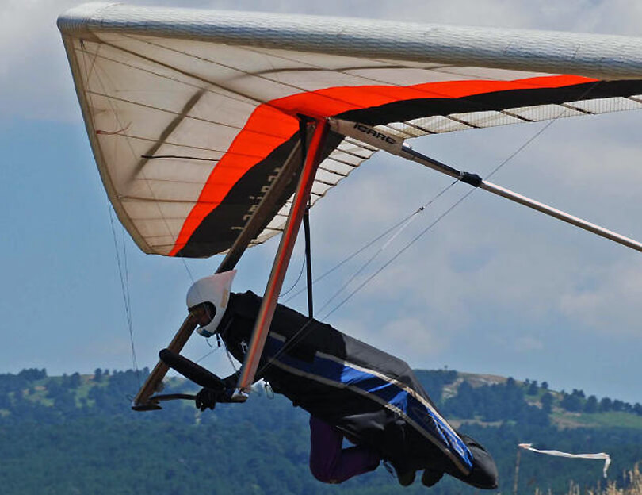
Hang gliding
It is a dangerous sport that is really famous in Greece. The athlete jumps off a cliff and flies a light, non motorised foot-launched heavier-than-air aircraft an object like a parachute. A skilled athlete can gain a lot of height from the wind and performs different tricks. This sport requires years of practice and a lot of skill that only a few people can manage to do

Slide 15
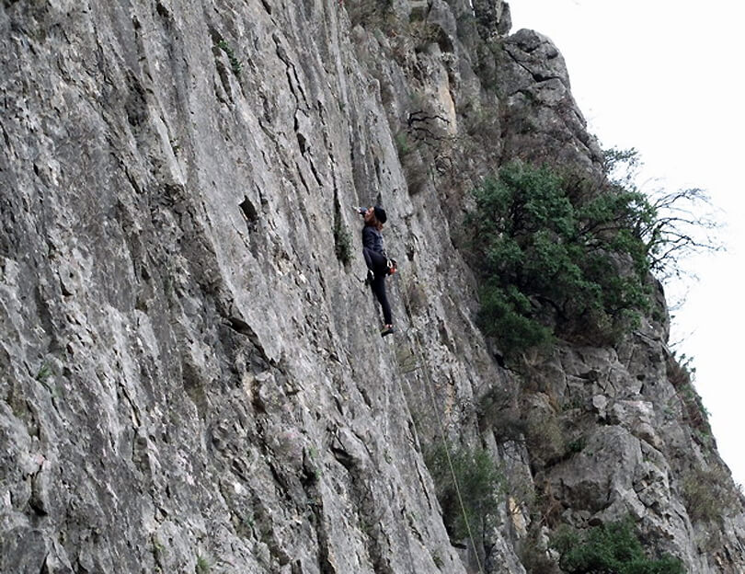
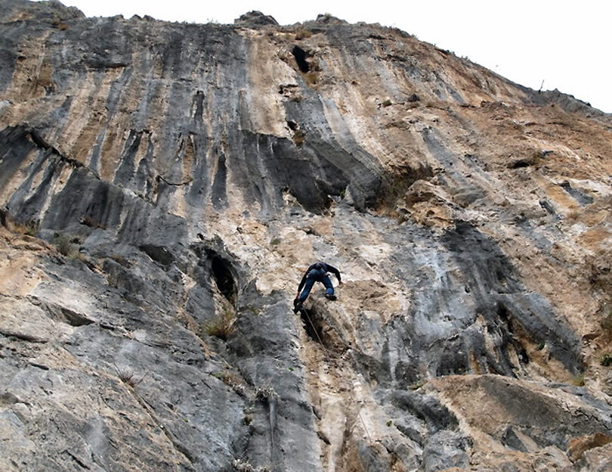
Rock climbing
This is also a pretty dangerous sport that not all people can do. It is pretty famous in all parts of the world and many people have lost their lives from this. The athlete must climb a mountain cliff with some special equipment. The only safety measure is the rope they are tied on. But when people reach the top, they say that the view is amazing

Slide 16
Our school
Exploring our school

Slide 17
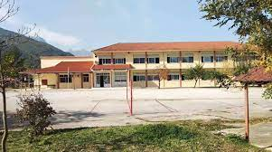
School community
Our school consists of:
80 students between 15-18 years old
19 highly skilled teachers
3 more personel and 1 psychologist

Slide 18
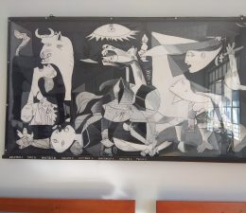
Building
Our school consists of 2 floors and was constructed in 1970.
It comprises 12 classrooms, 1 science lab, 1 computer lab and 1 technology lab. It also has an amphitheater for events and a library called <<Ithomi>>
It is decorated by paintings that some students made

Slide 19
Main targets
Providing high-class education
Understanding of social and historical reality
Evolution of the student's abilities
Cultivation of democratic ethos and behavior
Development of the solidarity system

Slide 20
Actions
Our school organises many activities in relation to sports, social, environmental and cultural issues
Takes part in competitions and activities that highlight student's abilities

Slide 21
Examples of school actions

Slide 22
An important moment for our school
Champions of Greece 2013 Geniko Lykeio Mouzakiou

Slide 23
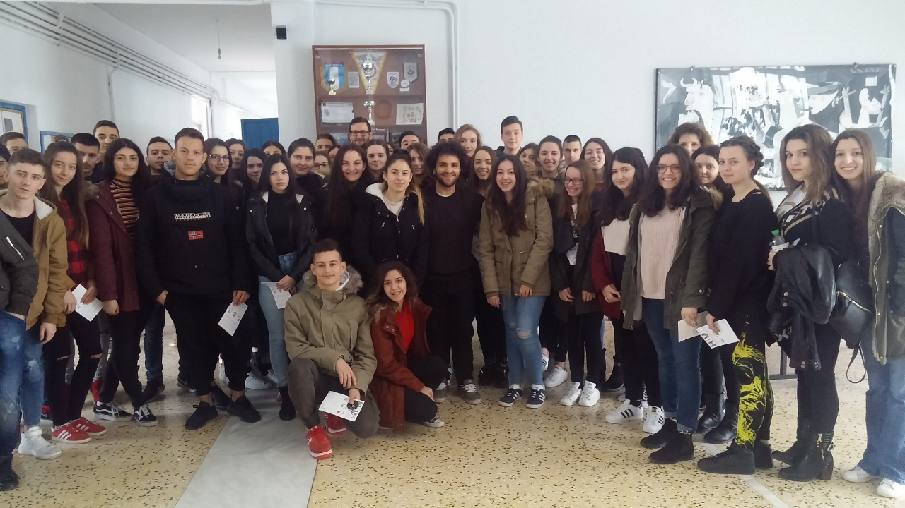
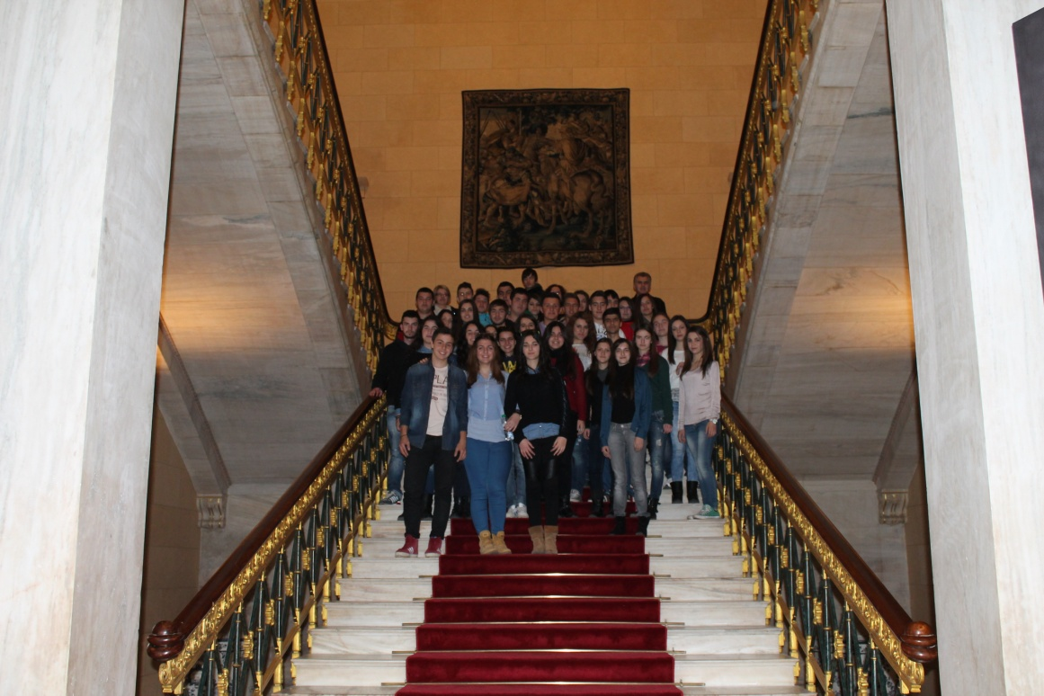
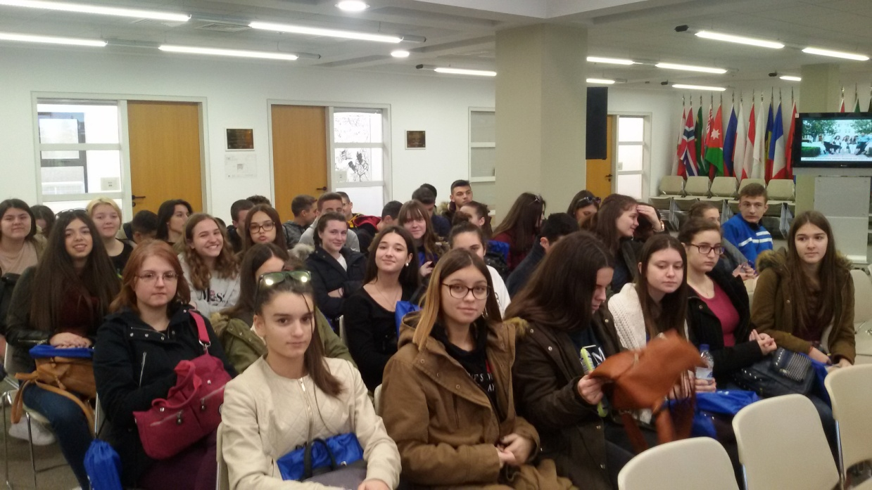
School event
School trip to the Greek Parliament
American College

Slide 24
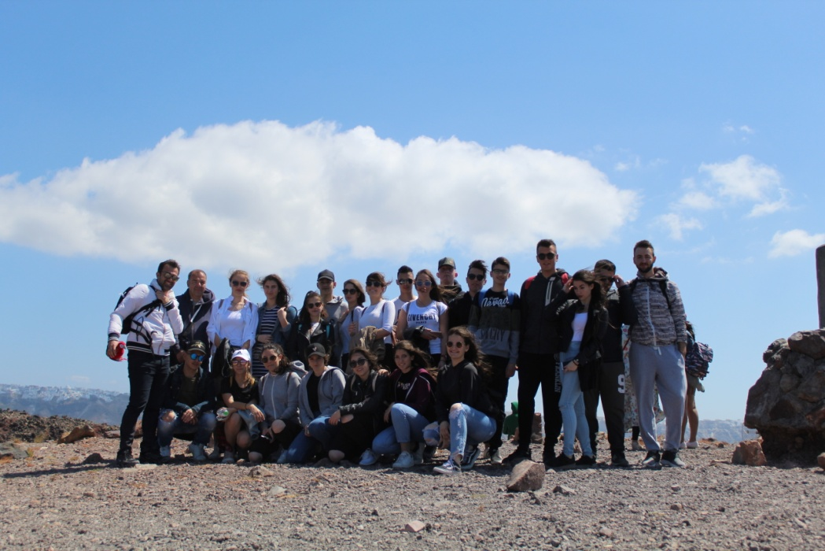
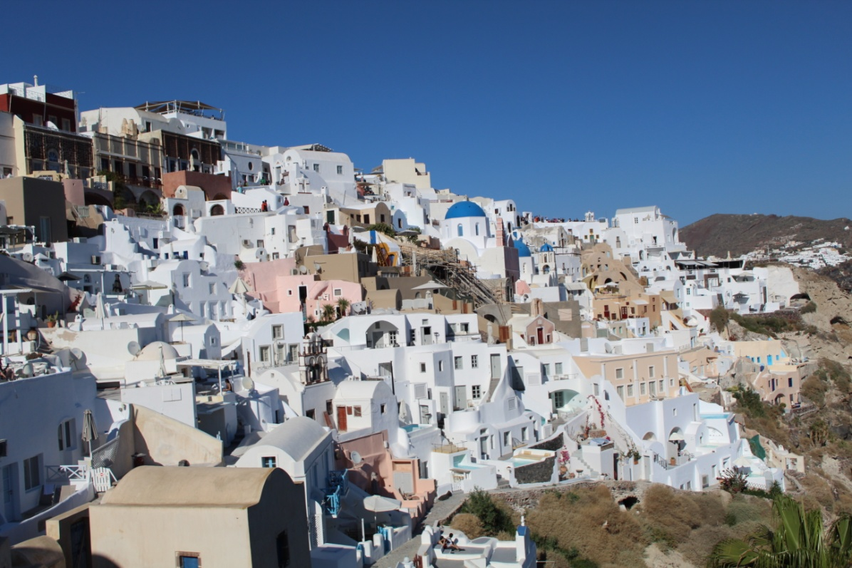
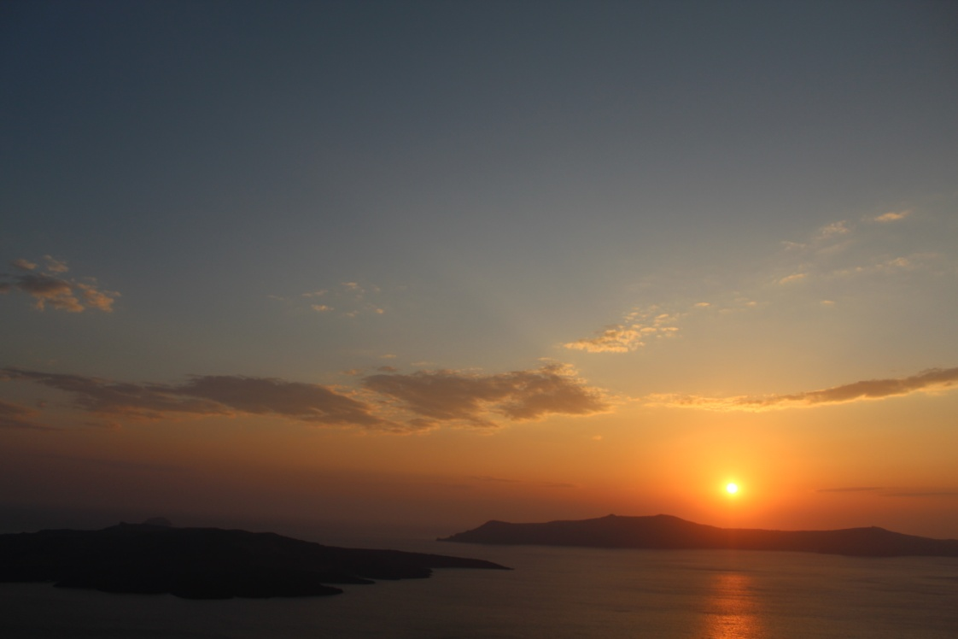
Santorini

Slide 25
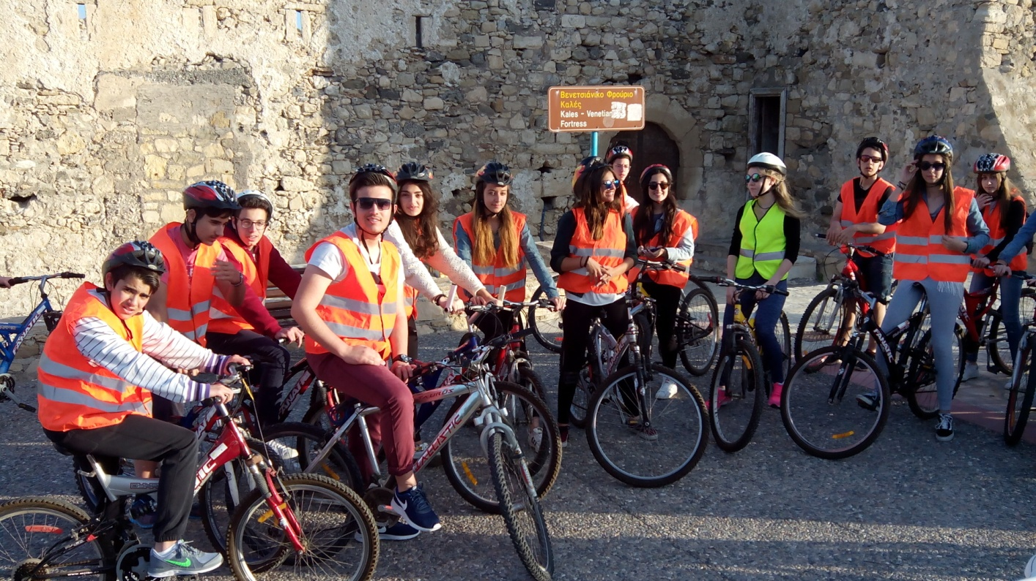
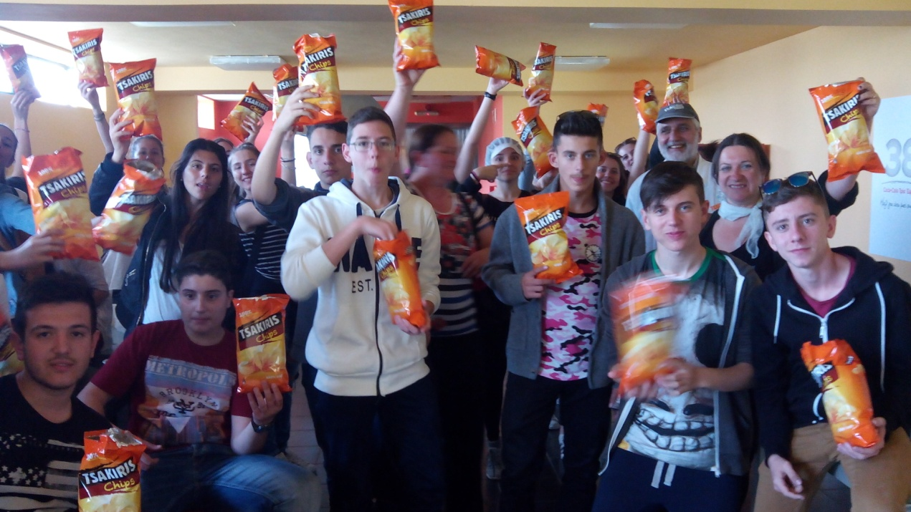
Ierapetra
Atalanti

Slide 26
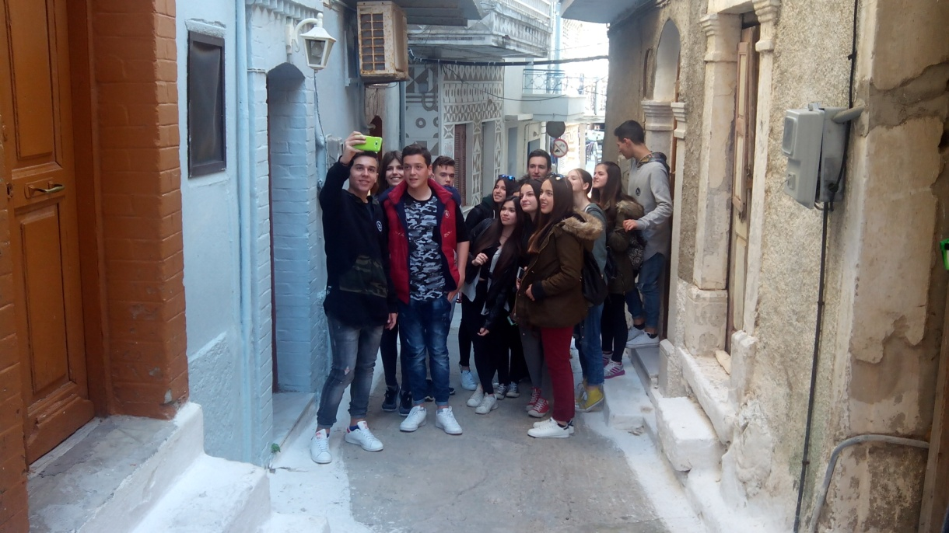
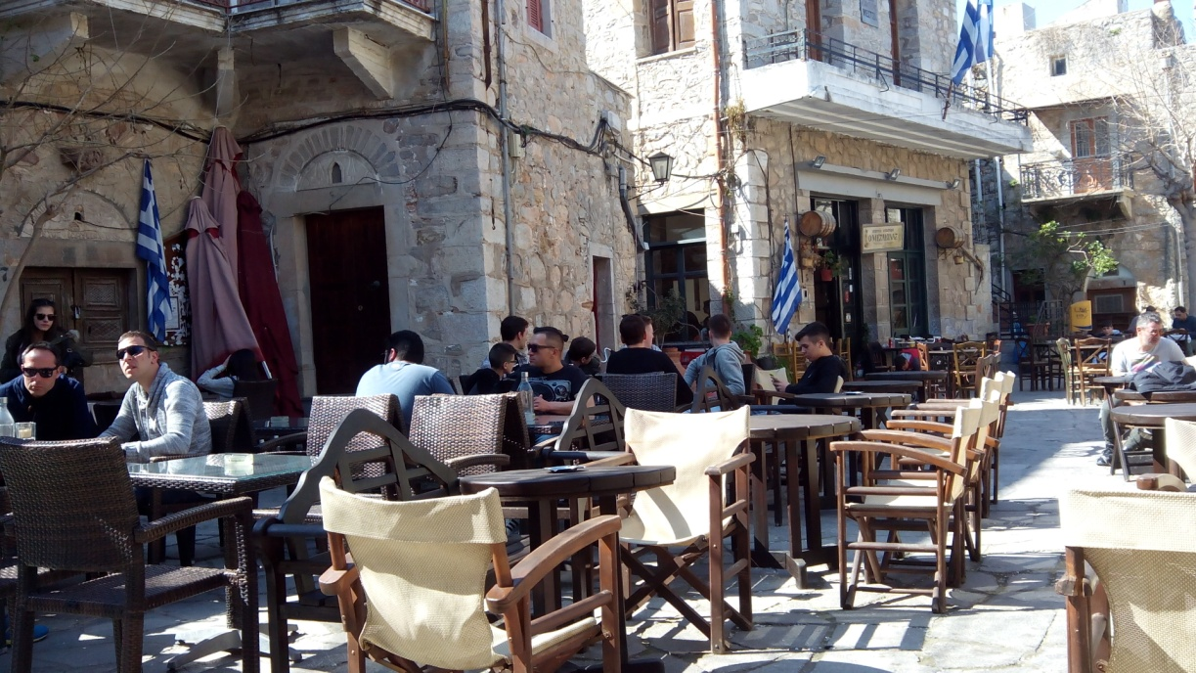
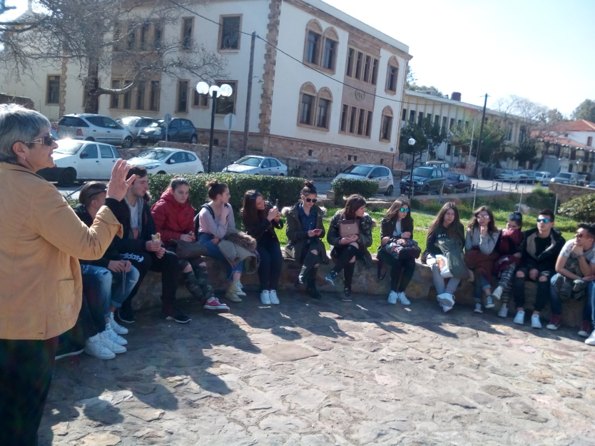
Chios

Slide 27
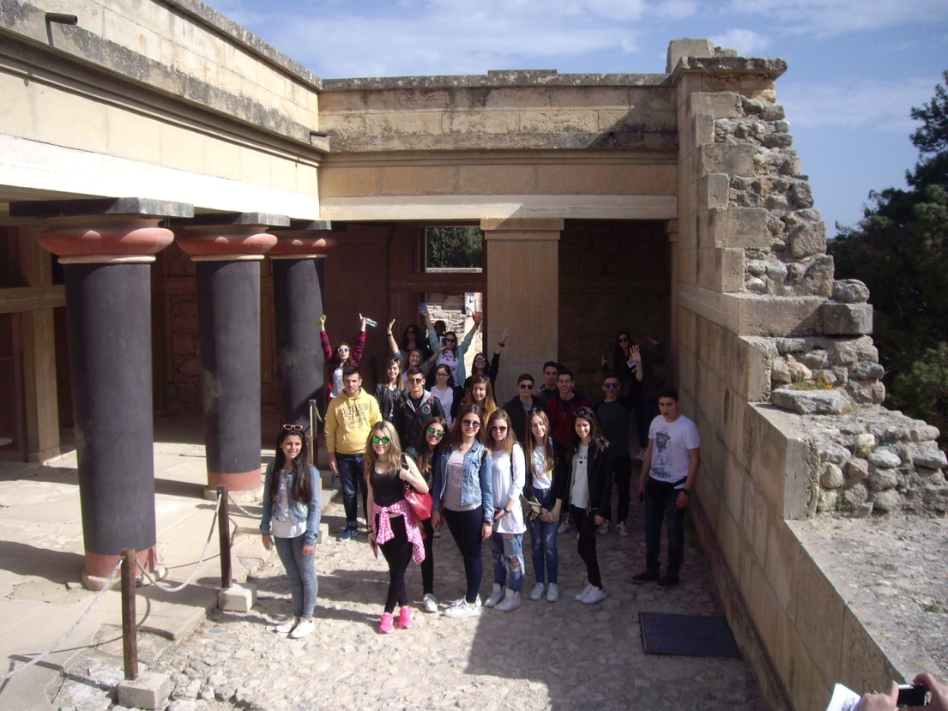
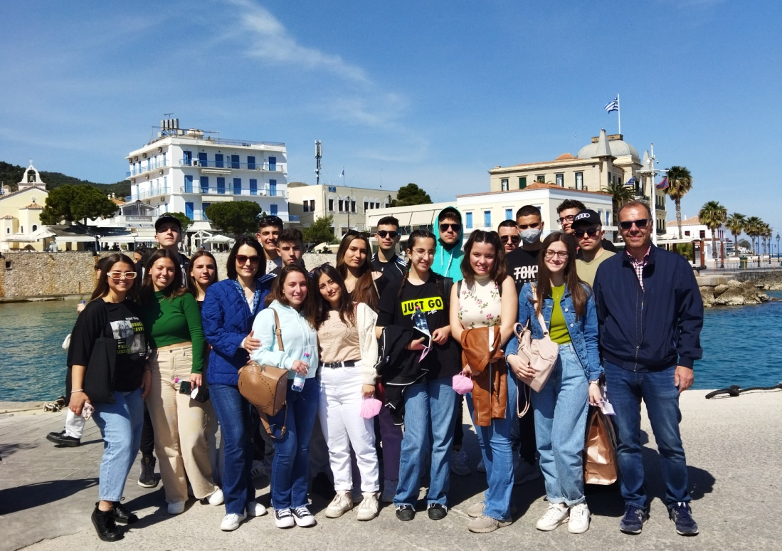
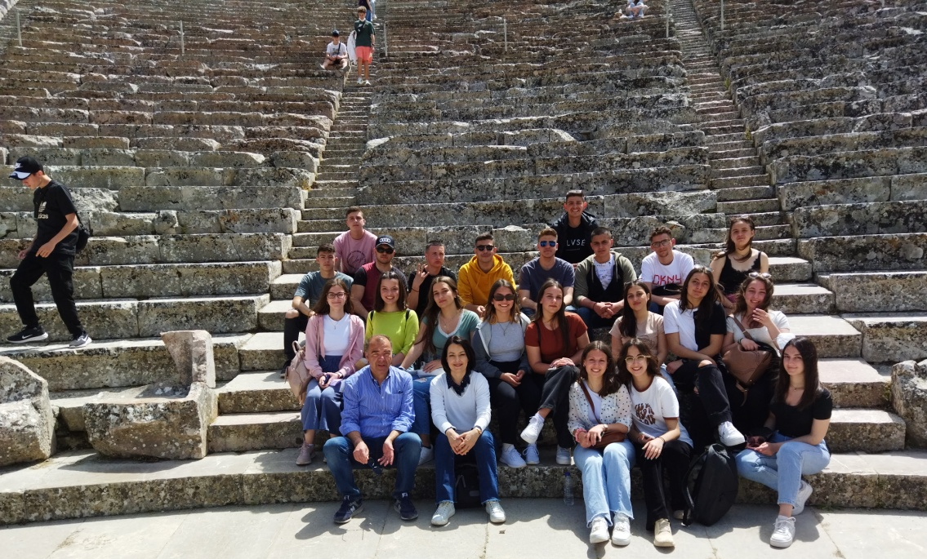
Spetses
Knosos
Epidayros

Slide 28
Thank you for your attention

